Slide 1
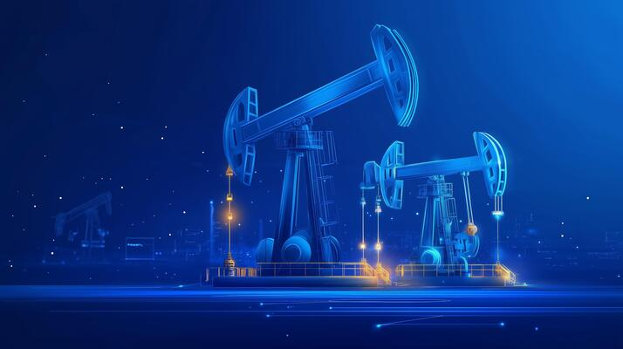



IPEMIGAS
Bahagian Malaysia
4 August 2025

Slide 2

